Slide 1
Ninja Ball
A pinball inspired platformer

Slide 2
Overview
Embark on a Quest to the top of the tower to defeat the evil shogun.
Fun levels full of pinball inspired obstacles.
Fast paced platforming.
No death penalty to retain a sense of quick progression.
Notes:
Ninjaball will see you progressing up a series of increasingly challenging levels to reach the top of the tower, the levels will use the vertical space
Provided by the phone screen to progress onwards, using the environment to your advantage to move through the level. We decided on a pinball theme as we liked the visual and mechanical elements that a pinball game can have with this kind of platformer.
We decided to use the mobile platform to make Ninjaball as we found that there werent many level based mobile platformers out there that took advantage of the features of the device.
Most turning the screen sideways and trying to squeeze in standard control schemes to make a more traditional platfomer or abandoning traditional controls all together and making more simple games. We wanted to try and work with the features of this device to see what new direction we could take.

Slide 3
Gameplay
All levels will have the player start at the bottom of the level and attempt to move up to the top of the screen.
Platforming will rely on the various obstacles to propel the player through the level.
Notes:
We realised that many of the features seen in pinball games could be used in this kind of platformer to promote fun fast paced gameplay,
Flippers, bumpers and springs could be used as obstacles or as a means to move through the level, making each level unique and enjoyable.
And the obstacles can be used in a variety of ways allowing us to create increasingly difficult levels to challenge player skill.

Slide 4
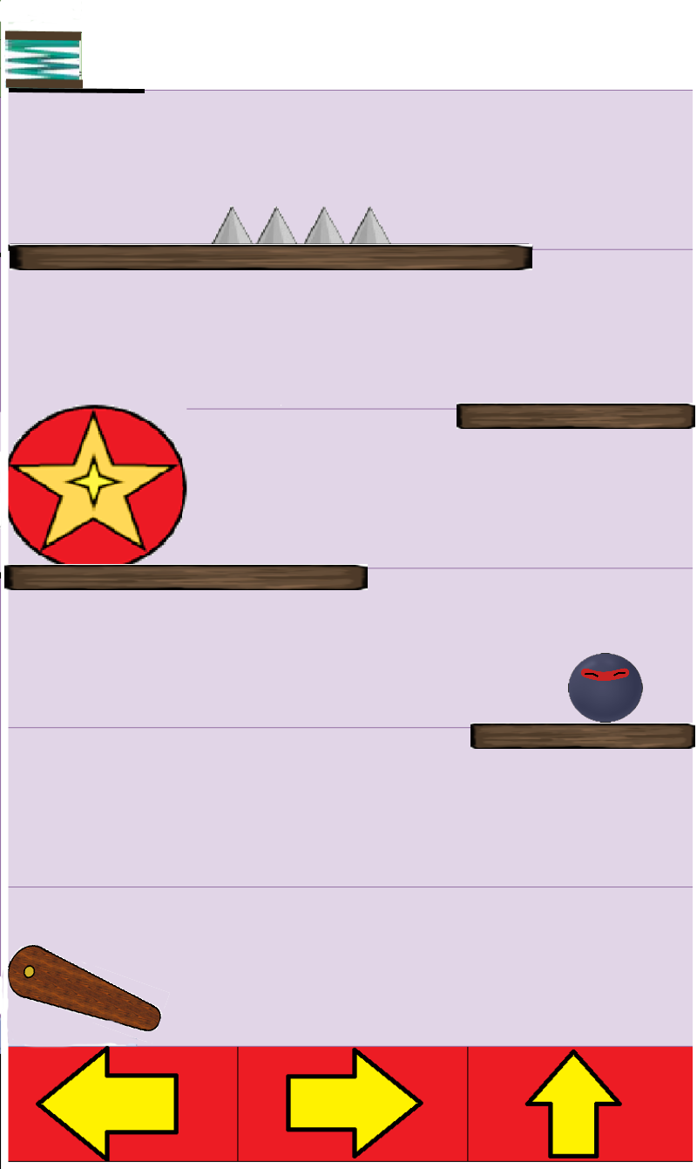
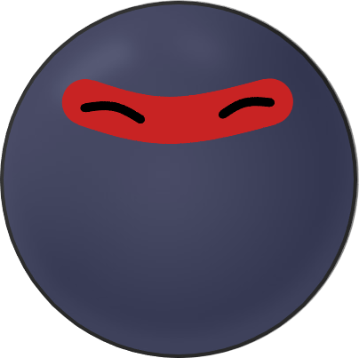
Character design and controls
Vertical phone screen.
3 buttons: left, right and jump.
Easy mid air control.
Notes:
Vertical phone screen gives us a narrower and more vertically spaced level than most traditional platformers and so we decided to utilize this to create platforming levels where the challenge is more in moving upwards then onwards. The relatively few controls means that each button can be made large and easily accessible even on smaller phone screens. We also decided on a relatively simple character design to make it easier to recognize on a small screen.

Slide 5

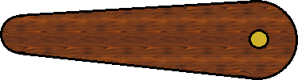
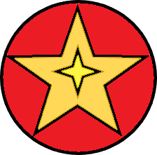
Obstacles
spikes kill on contact.
flippers throw player in a given direction.
bumper bounces the player back.
spring fires player into next level.
Notes:
Our main concern when designing the obstacles was to make them easy to recognize and understand, the flipper and bumper were designed to fit the pinball theme.
And we chose the spikes and spring from the site opengameart.org as they show clearly their function in the level.

Slide 6
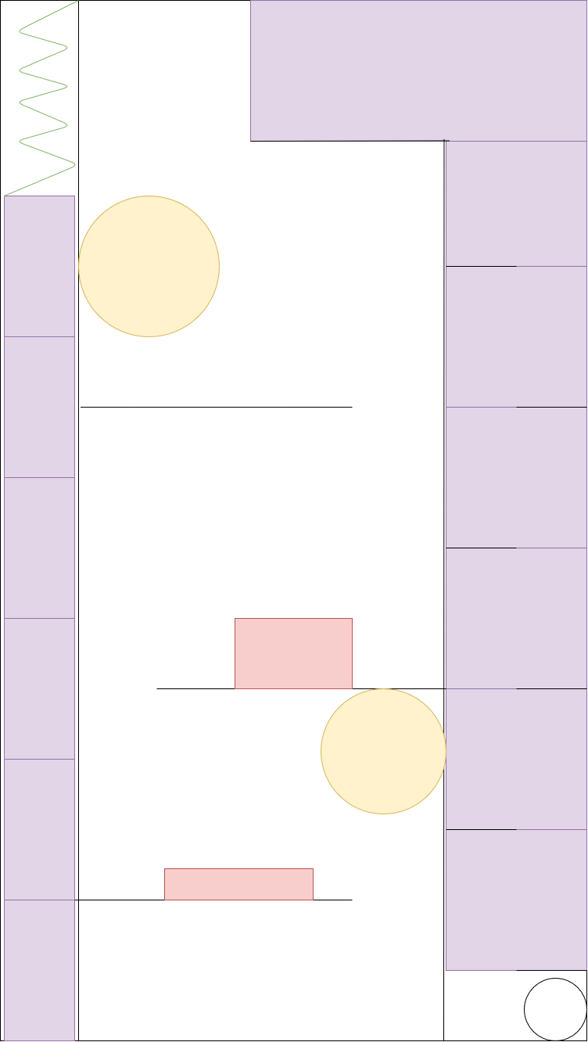
Level design
Tight compact levels using more verticality than normally seen in a platformer.
<various level designs including boss level>
Notes:
In the level design we tried to efficiently use the space provided while still providing a varied and playable level, we found in our sketches that this aspect ratio lent itself towards faster paced wide open levels that relied heavily on the various obstacles to progress or, and also to slower paced levels that wind from top to bottom, and rely more heavily on spikes and where bumpers can be used as more of a hazard then a tool.

Slide 7

Audio
Bumper sound
Flipper sound
Level transition
Notes:
The audio seen here is taken from freesounds.org and are taken from noises of a pinball machine. Level transition is the sound of the spring firing a new ball into the machine.

Slide 8
Staff
Tomas Crowley
Dawid Kocik
Ronan McMorrow
Oscar Bogenberger
Elliot Cleary

Slide 9
Risks
Possible issues in maintaining a consistent level size.
Not much experience in Corona could be unforeseen technical difficulty.
Possible difficulty in making a sufficient amount of content
Notes:
Due to how we have decided to lay out our levels differently to most standard platformers and due to the size of the screen we may have difficulty in creating enough varied levels. None of us have experience in lua or corona past the labs either so we might have some difficulty in the coding aspect as well. Because of both of these difficulties it may be difficult to make enough content in the time we have.

